Slide 1
Containerizing Neural Network Apps for Medical Compute
Sprint 4
Mentors: Rudolph Pienaar, Sandip Samal
Group Members: Ken Krebs, Brian Mahabir, Tingyi Zhang, Cagri Yoruk, Xiaoyu An

Slide 2
Total Project Deliverables: Where we are
2 working pipelines for two different types of classifiers.
2 phases of each pipeline
Training :
Train models using two different types of classifiers (one classifier to identify multiple parts of the brain, the other to utilize multiple classifiers to identify specific parts of the brain)
Infererence :
Use models to infer data about brain structure volume and output text report.
Deployment of these pipelines on MOC *
Notes:
So we wanted to share where we are for our MVP. For our pipeline we are at the inferences stage specifically we have finished exploring two types of classifiers and are on to creating text reports from the inference pipeline. For MOC we are still in the deployment stage of pfioh and pman and still debugging errors which we will talk about more indepthly later on.

Slide 3
Sprint 4 Accomplishments
Begin training models for specific labels that pertain to a certain part of the brain and our results
Modify existing plugins to facilitate training and correlate inputs and outputs in the workflow
Develop additional plugins for interpreting results (pl-heatmap)
Continue working on deploying to the MOC
Notes:
More specifically this is the accomplishments of our sprint 4. Our workflow group has trained models for identifying specific parts of the brain, modified plugins to facilitate training and made sure inputs and outputs of plugins matched in the workflow, also they developed plugins for interpreting results. For our MOC team we continued to debug our authentication issue spoken about in our last sprint and this introduced more problems that our mentors are currently helping us with.

Slide 4
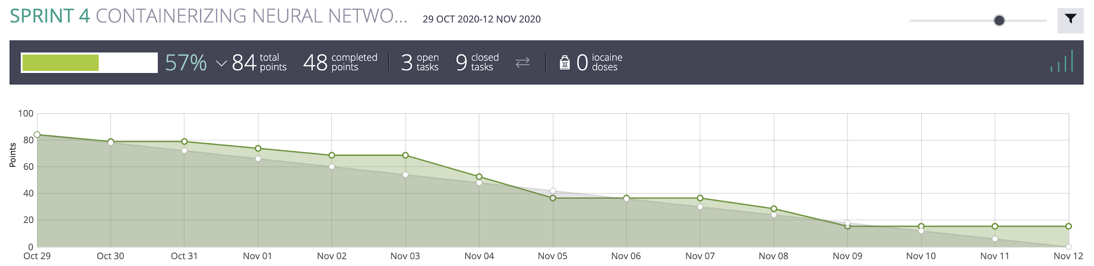
Burn Down Chart
Notes:
This is our burn down chart. This chart shows we did not finish the deployment of MOC which was targeted for sprint 4.

Slide 5
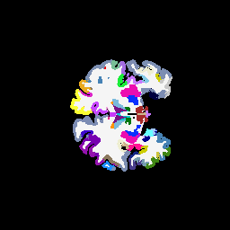

Sprint 4: Training Specific Classifiers
Current plugins exist to separate patient mgz files into separate labels for each part of the brain.

Slide 6
Plugin to separate labels
pl-mgz2imageslices
Input consists of multiple patient directories of mgz files
Output of mgz2imageslices consists of a directory for each patient, consisting of directories for each label, consisting of mask images for the label
Label n
mask &
.npy
Multiple patient
directories
Label 1
Masks
aparc....mgz
.mgz
mask &
.npy
Label 1
png
Patient 1
Label 2
png
png
pl-mgz2imageslices
png
Label 192
png

Slide 7
Problems Connecting Outputs and Inputs
pl-mgz2imageslices
Training Plugin
pl-mricnn
Label n
Training Images
mask &
.npy
Multiple patient
directories
mask
pl-mricnn
Label 1
train
aparc....mgz
.mgz
mask &
.npy
Training model requires single .npy file for all masks and single .npy file for all training images
Output of mgz2image slices separates each patients labels with their own .npy file resulting in n .npy files
.npy
Trained Model
pl-mgz2imageslices

Slide 8
Problem
Our solutions
The output of our plugin to separate mgz file into specific labels is not easily compatible with inputs for the training model plugin.
Requires separating each patient’s labels into their own directories.
.npy files are not suitable and need to be modified.
Modify other existing plugins to make outputs compatible.
Modify training plugin to train multiple labels at once.

Slide 9
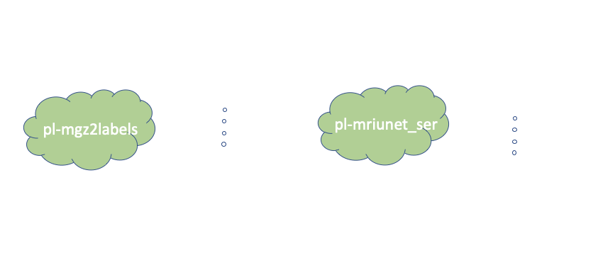
Label-wise classifier training pipeline
.mgz
Plugin
Plugin

Slide 10
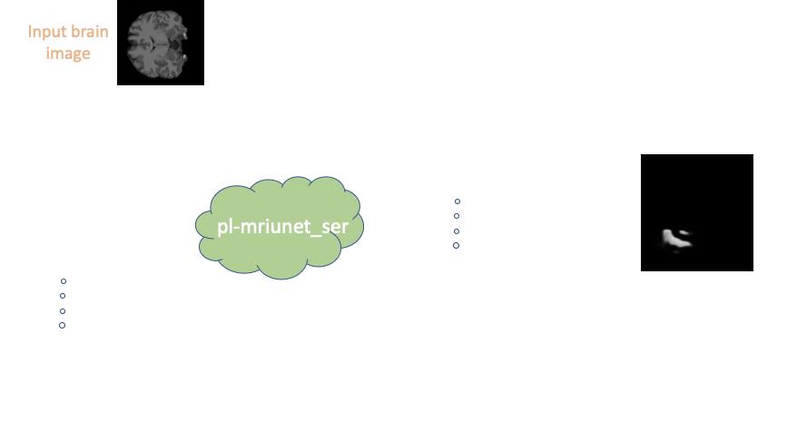
Label-wise classifier inference pipeline
Plugin

Slide 11

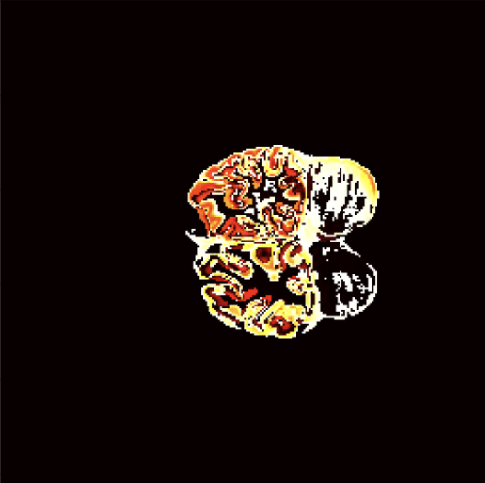
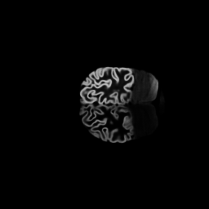
pl-heatmap
Plugin developed to inspect differences between inferred images and ground truth training masks.
Low contrast grayscale images are difficult to differentiate between labels
Inferred Labels
Ground Truth Mask

Slide 12

Demo

Slide 13
MOC deployment
As we talked about in our last demo we were getting HTTP related issues while running scripts on pfioh (I/O Handler). Upon further inspection and discussion with our mentors and developers of the ChRIS, we found out about malformed HTTP headers and bodies in pfioh. The process:
Missing Header → Minor Bug Fixes → Swift Keystone Auth?
400 Bad Request → 502 Bad Response → 401 Authentication Error

Slide 14
Next
Training models (more time and more data)
Generate text report from images (the last part of the whole pipeline)
MOC deployment

Slide 15
Thanks

